Slide 1
CSCI 45 – Assembly Floats
Professor Kerney

Slide 2
Agenda
3D array accesses
Doing floating point math in ints
More NEON
IEEE 754 – Floating Point Format

Slide 3
3D Array Accesses
We’re processing data loaded by the CImg library. It puts all of the red pixel data into a contiguous array, one row at a time, then all the green, then all the blue.
So one x value will be next to the next x value in memory.
i.e. (2,9) will be next to (3,9), as we’re going down the row.
Cache locality: always iterate along memory!
Other image libraries will “interleave” the color data, so the array holds one red value, then one green, then one blue, then the next red, and so forth.
NEON has commands for handling this, using the vector load 3 command, which will automatically un-interleave the data for you.

Slide 4
3D Array Accesses
For 1D arrays, calculating the memory address to read from is easy. arr[50] = arr + 50 * sizeof (unsigned char).
Remember: arrays are pointers and pointers are arrays, and they’re all just 32-bit memory addresses on our system.
For the color array that we’re reading from, it’s basically a three dimensional array: arr[color][height][width].
So let's say we want the red value at coordinate (5,9), it’s like we’re trying to access arr[0][9][5] = arr + 9*width + 5
If we want the green value at (5,9), then we have to move past all width*height values in the red part:
The address to read from is: arr + width*height + 9*width + 5
And if you want the blue value: arr + 2*width*height + 9*width + 5

Slide 5
3D Array Accesses
I give you all this code in C, you have to figure it out in assembly.
You can use the C preprocessor in assembly files if you rename the file from .s to .S (i.e. capital S).
Would probably be easier to use a function.

Slide 6
Floating point using ints
Floating point math, especially division, can be very slow.
Here’s a key observation: if you’re going to be multiplying a 8-bit value by a floating point number like 0.23430312480312, and storing it back into a char, all that extra precision is just going to be wasted, because the result has only 8 bits.
POWER TRICK: so convert any number you want to multiply a char by to a fraction of 256. Why?
Because dividing by 256 is a simple and FAST 8-bit shift.
For example, the first magic number in sepia toning is 0.393.
0.393 * 256 = 100.6. So we’ll call this 101/256
So we multiply our value by 101, and then right shift 8 times.

Slide 7
Floating point using ints
Catch: multiplying two eight bit values means you need 16-bits of space for the result, at least temporarily.
Example: multiply 122 by 0.393.
char x = 122;
short y = x * 101; //Move from 8-bit to 16-bit temporarily
x = y >> 8; //Divide by 256, store the result in 8-bit x
Wrap this in a loop loading and storing values from an input and output array, and you have a functional bit of code.
Error: this approximation above gives you 48.133; full floating point math would have given you 47.946. With rounding, it should be the same, without rounding you might be off by 1.

Slide 8
How to do this in NEON
Move from 8-bit to 16-bit (d10 holds our original data):
vmovl.u8 q0, d10
Multiply two vectors (q1 holds the integer fractions to multiply):
vmull.u16 q2, q0, q1
Right shift and narrow to 8-bits, saturating result:
vqshrn.u16 d10, q0, #8
The q in the instruction stands for “saturate”, which means if the value exceeds 255 it will be set to 255.
Combine with some vector loads and stores, and you’ve got an operational sepia tone program.

Slide 9
The Real Deal floats
So far this semester, we’ve avoided talking about floating point numbers in assembly because they’re slow.
...and because ARM doesn’t support them by default.
If you want floating point support on an ARM chip, you have to buy an ARM chip that includes it. Not all do! Cheap ones have to do everything in integers.
Normal registers in the ARM32 standard (R0-R15) are all integer registers, either signed or unsigned.
If your CPU has support for floating point, then you have a second set of registers, named S0-S31 (S = single precision).
If your CPU has NEON support, then you also have D0-D31 and Q0-Q15 (D = double wide registers, Q = quad wide).

Slide 10

The Real Deal

Slide 11
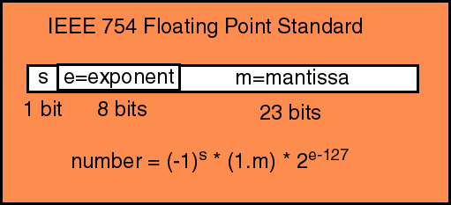
The IEEE 754 Floating point standard

Slide 12
The IEEE 754 Floating point standard
S = the sign bit. If it’s 1, it’s negative. 0 for positive.
E = exponent. It’s always positive (from 0 to 255) BUT...
The actual meaning is the value minus the “bias”, which is usually half the range (127 for 32-bit floats).
So if you have 10000000 (128) this means 2⁽¹²⁸⁻¹²⁷⁾ = 2.
E = 10000001 (129) means 2⁽¹²⁹⁻¹²⁷⁾ = 4.
M = mantissa. All numbers are first normalized so that they have a 1 in the first position (how many times you have to shift them right or left to get there is held in E).
We then drop the 1, since it’s unnecessary*.
The bits we write down are fractions.

Slide 13
Mantissas Explained
In normal binary numbers, each more significant number is twice the value of the number to its right.
For example: 111 = 4 + 2 + 1 = 7.
In mantissas, this is still true, except they represent numbers below 1: ½, ¼, 1/8, 1/16, 1/32, etc.
So we could represent 0.75 as ½ + ¼ + 0 + 0 + 0, or 0.11000.
But in reality, we’d do this calculation, and then left shift it once (remembering this for the exponent), to get 1.1000, and then we will drop the leading one, for 1000 written to M.
Some numbers are easy to represent (0.75), some are hard (1/3). It all boils down to how close they can get to powers of 2.

Slide 14
Example #1: 3.0
Convert 3.0 to floating point.
The sign is positive, so S = 0
3.0 in normal binary is: 11.0
We need to right shift it once to get a leading 1: 1.10
So the unbiased exponent will be 1 (meaning one right shift).
Therefore, E = 128. (Remember the -127 bias.)
We have one digit after the decimal place, so the mantissa will be 1000000000....0
In binary: 0 10000000 10000000000000000000000

Slide 15
Example #2: 3.25
Convert 3.25 to floating point.
The sign is positive, so S = 0
3 in normal binary is: 11; 0.25 is 0.01, so: 11.01
We need to right shift it once to get a leading 1: 1.101
So the unbiased exponent will be 1 (meaning one right shift).
Therefore, E is again 128: 10000000
We have three digits after the decimal place, so the mantissa will be 1010000000....0
In binary: 0 10000000 10100000000000000000000

Slide 16
Example #3: 8.25
Convert 8.25 to floating point.
The sign is positive, so S = 0
8 in normal binary is: 1000; 0.25 is 0.01, so: 1000.01
We need to right shift it thrice to get a leading 1: 1.00001
So the unbiased exponent will be 3 (meaning three right shifts).
Therefore, E = 130: 10000010
We have four digits after the decimal place, so the mantissa will be 0000100000....0
In binary: 0 10000010 00001000000000000000000

Slide 17
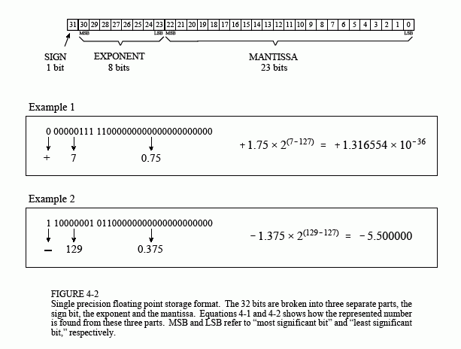
More examples

Slide 18
Special cases
There is both positive and negative zero. S = 0, S = 1.
You can specify infinity with all 1s in exponent & 0s in mantissa
S = 0 and S = 1 distinguishes between positive and negative infinity
You can specify either signaling or quiet NaN with all 1s in the exponent and either a 0 in the first bit in the mantissa (signaling) or a 1 in the first bit (quiet).
The rest of the mantissa cannot all be 0 for signaling or it’d be inf.
The sign bit doesn’t matter.
The rest of the bits don’t matter, but can be used to hold error data
Signalling means an exception should be thrown, quiet will percolate the value forwards.
All 0s in exponent signals a denormal, which means there’s no implicit leading 1 in the mantissa.

Slide 19
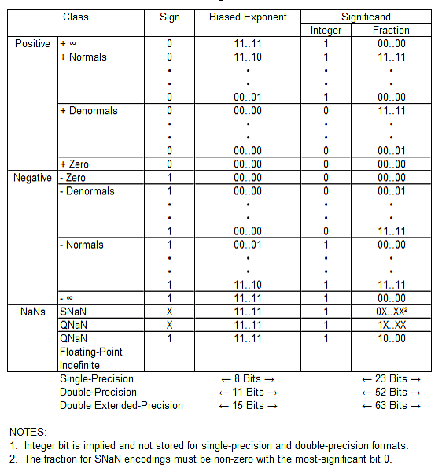
Special Cases

Slide 20
Doubles
Doubles are 64-bit floats. They have an extra three bits of exponent (11 bits total) and over twice the precision in the mantissa (52 bits instead of 23).
They still have the one sign bit.
Their bias is 1203.
Otherwise, they work exactly the same way, including with all the weird cases like inf and NaN.
8.25 as a double is: 0 10000000010 0000100000000000000000000000000000000000000000000000

Slide 21
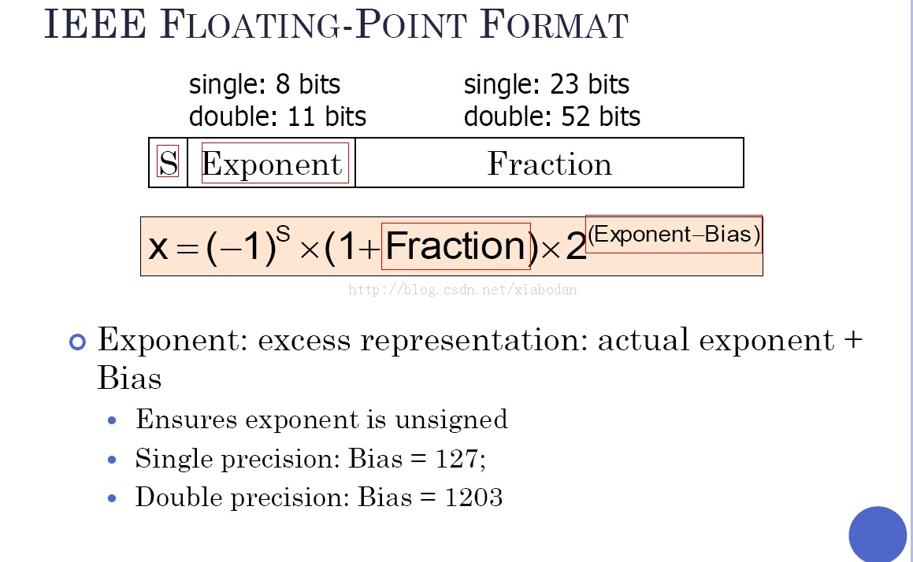
Single vs. double precision

